Slide 1
Matrix Multiplication Algorithms
Link to github with the program:
https://github.com/ctmayton/strassen_multiplication_benchmark
By: Jonah Robbins, Chase Mayton, Noah Davis, Corbin Johnson

Slide 2
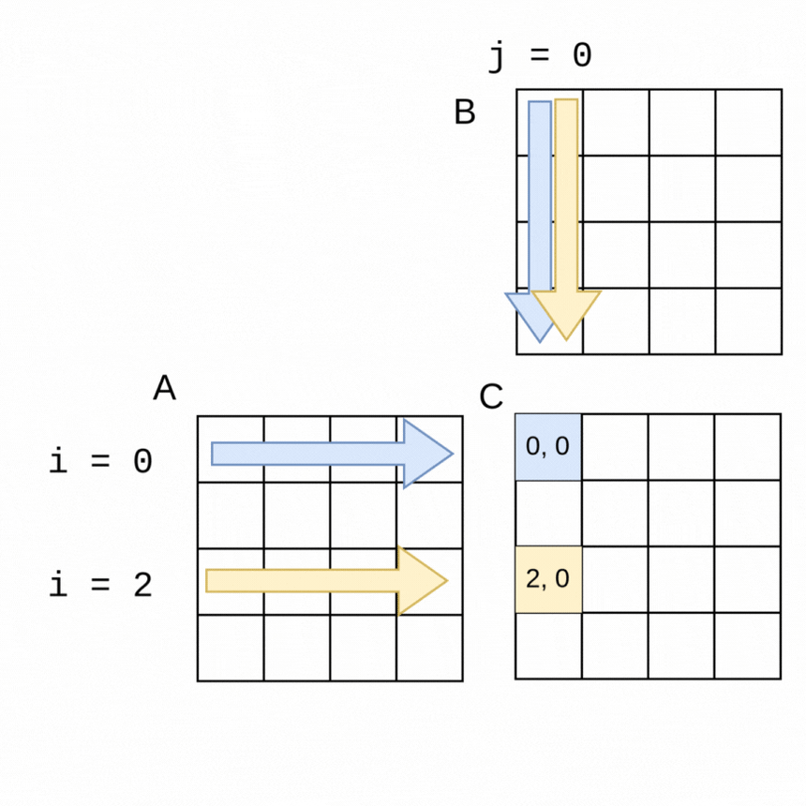
What is Matrix Multiplication

Slide 3
Why it’s useful
One easy real world example you can use to find the use of Matrix Multiplication is by having to take inventory at a shipping company.
 | Cedar | Birch | Maple
Mon | 3 | 5 | 9
Tues | 7 | 1 | 4
Wed | 1 | 6 | 3
Thurs | 6 | 9 | 8
Fri | 4 | 1 | 6
 | Weight | Cost
Cedar | 8lb | $20
Birch | 12lb | $16
Maple | 10lb | $15
 | Weight | Cost
Mon | 174lb | $215
Tues | 108lb | $216
Wed | 110lb | $161
Thurs | 236lb | $384
Fri | 104lb | $186

Slide 4
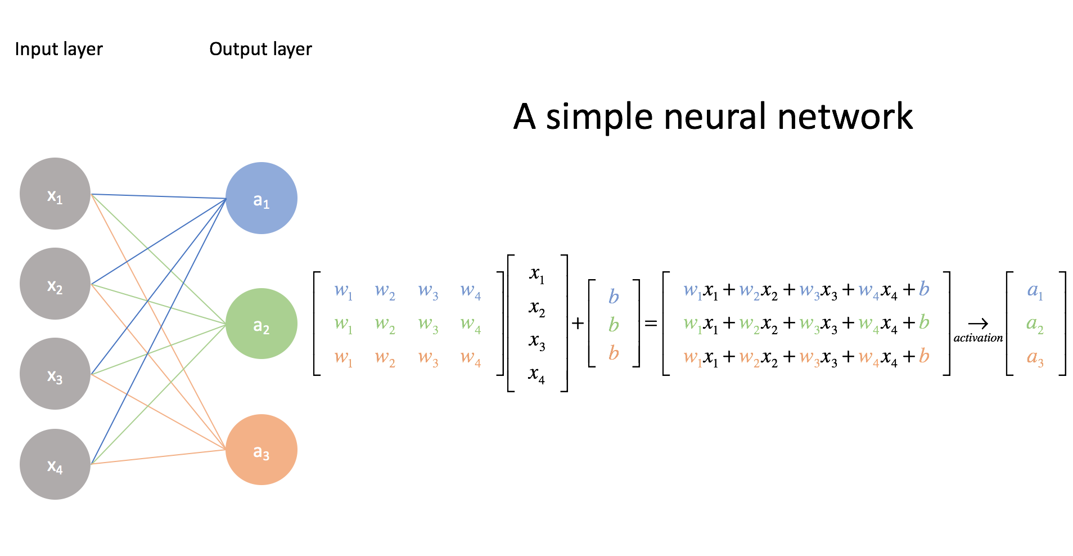
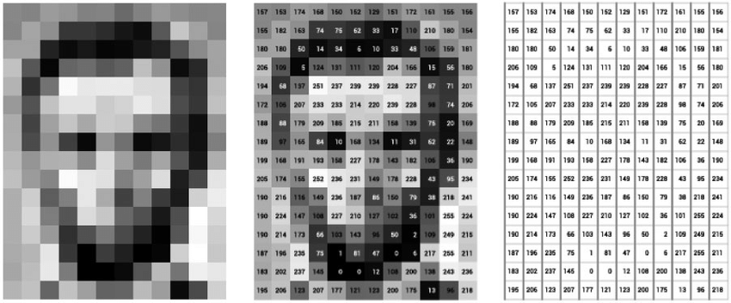
Why it’s useful
3D Modeling
Image manipulation
Processing AV signals
Neural Networks
Graph analysis
etc.

Slide 5

Research Questions:
How does the runtime of matrix multiplication scale as the size of the input matrices increases?
How does the performance of a manually implemented matrix multiplication algorithm compare to an optimized library implementation?

Slide 6
Standard Matrix Multiplication
*
A11 | A12
A21 | A22
B11 | B12
B21 | B22
C11 | C12
C21 | C22
=
C11 = (A11* B11) + (A12*B21)
C12 = (A11* B12) + (A12*B22)
C21 = (A21* B11) + (A22*B21)
C22 = (A21* B12) + (A22*B22)
Multiply Matrix A with Matrix B into Matrix C by taking the dot product of a row from Matrix A and a column of Matrix B.
The number of columns of Matrix A must equal the number of rows of Matrix B.
When thes size of A is m×n and B is n×p, then the size of C will be m×p.

Slide 7
Standard Algorithm Code
ALGORITHM MatrixMultiply(A[0..n−1][0..n−1], B[0..n−1][0..n−1])
// Computes the matrix product of A and B
// Input: Two n × n matrices A and B
// Output: Matrix C = A × B
create C[0..n−1][0..n−1]
for i ← 0 to n−1 do
for j ← 0 to n−1 do
C[i][j] ← 0
for k ← 0 to n−1 do
C[i][j] ← C[i][j] + A[i][k] × B[k][j]
return C
Iterates through every row of A and every column of B
Computes each entry of C using dot products
Uses three nested loops → Θ(n³) arithmetic operations
Requires only output matrix space → Θ(n²) memory

Slide 8
Standard Algorithm Empirical Analysis
Standard Algorithm has 3 for loops:
  For i = 0 to n-1
  For j = 0 to n-1
  For k = 0 to n-1
Basic Operation is C[i][j] ← C[i][j] + A[i][k] × B[k][j], so multiplication
Empirical Analysis:
  I = 0 ∑ n-1 ( j = 0 ∑ n-1 ( k = 0 ∑ n-1 (1))) = n^3
The standard algorithm for matrix multiplication has a time complexity of Θ(n^3).

Slide 9
Strassen Matrix Multiplication
*
A11 | A12
A21 | A22
B11 | B12
B21 | B22
C11 | C12
C21 | C22
=
M1 = (A11 + A22) * (B11 + B22)
M2 = (A21 + A22) * B11
M3 = A11 * (B12 - B22)
M4 = A22 * (B21 - B11)
M5 = (A11 + A12) * B22
M6 = (A21 - A11) * (B11 + B12)
M7 = (A12 - A22) * (B21 + B22)
C11 = M1 + M4 - M5 + M7
C12 = M3 + M5
C21 = M2 + M4
C22 = M1 - M2 + M3 + M6
Divide the matrix into four submatrices.
Plug the subtricies into the given equations then combine them to get the final product.
Strassen’s Matrix Multiplication traditionally can only work with same sized square matrices.
Irregular matrices can be padded with zeros to be formatted into same sized square matrices.

Slide 10
Strassen Algorithm Code
ALGORITHM Strassen(A[0..n−1][0..n−1], B[0..n−1][0..n−1])
// Computes the matrix product of A and B using Strassen’s method
// Input: Two n × n matrices A and B
// Output: Matrix C = A × B
if n = 1
return [A[0][0] × B[0][0]]
// Partition A into submatrices
partition A into A00, A01, A10, A11
partition B into B00, B01, B10, B11
// Compute the 7 Strassen products
M1 ← Strassen(A00 + A11, B00 + B11)
M2 ← Strassen(A10 + A11, B00)
M3 ← Strassen(A00, B01 − B11)
M4 ← Strassen(A11, B10 − B00)
M5 ← Strassen(A00 + A01, B11)
M6 ← Strassen(A10 − A00, B00 + B01)
M7 ← Strassen(A01 − A11, B10 + B11)
// Compute output quadrants
C00 ← M1 + M4 − M5 + M7
C01 ← M3 + M5
C10 ← M2 + M4
C11 ← M1 − M2 + M3 + M6
// Combine into full matrix C
assemble C from C00, C01, C10, C11
return C
Uses divide-and-conquer: splits matrices into 4 equal blocks
Recursively multiplies smaller matrices
Reduces multiplications from 8 → 7, saving time
Uses more additions/subtractions to compensate

Slide 11
Strassen Algorithm Empirical Analysis
Since Strassen Algorithm is recursive, the recurrence relation can be written as T(n) = 7T(n/2) + O(n^2)
A = 7, B = 2, d = 2
Using the master theorem, 7 > 2^2, so Θ(n^(logb(a)))
Time Complexity: T(n) = Θ(n^(log2(7))), which is approximately Θ(n^2.807)

Slide 12
Standard Algorithm vs. Strassen Algorithm
The Standard Algorithm has O(n³) complexity because it uses three nested loops to compute each element. Strassen has O(n^2.807) complexity because it recursively divides matrices and uses only 7 multiplications instead of 8. However, this theoretical advantage doesn't mean Strassen is always more efficient in practice.
Significantly increased amounts of additions and subtractions make it so that it has a higher upfront cost that makes it less efficient for smaller algorithms
When the matrices are not square or not powers of 2, the Strassen Algorithm can lose efficiency because it will need to pad out the matrices to make it usable.
The increased number of additions and subtractions can cause numerical stability issues due to floating-point rounding errors

Slide 13

Video of Program:

Slide 14
Data we collected:
Size of matrices
Standard Time(Sec)
Strassen Time(Sec)
(1x1), (1x1) | 0.000007300011930055916 | 0.000028299997211433947
(2x2), (2x2) | 0.00000960000033956021 | 0.0000484000047435984
(5x5), (5x5) | 0.000021700005163438618 | 0.0007651000050827861
(10x10), (10x10) | 0.00010410000686533749 | 0.005520899998373352
(50x50), (50x50) | 0.006858900000224821 | 0.25825970000005327
(100x100), (100x100) | 0.05232400000386406 | 1.8707439999998314
(200x200), (200x200) | 0.39524070000334177 | 10.315698499995051
(500x500), (500x500) | 7.245535899986862 | 63.5475679999945
(1000x1000), (1000x1000) | 48.02211350000289 | 373.92874740000116
(2000x2000), (2000x2000) | 434.61519439998665 | 2505.734270999994
*All matrix values were set to 1

Slide 15
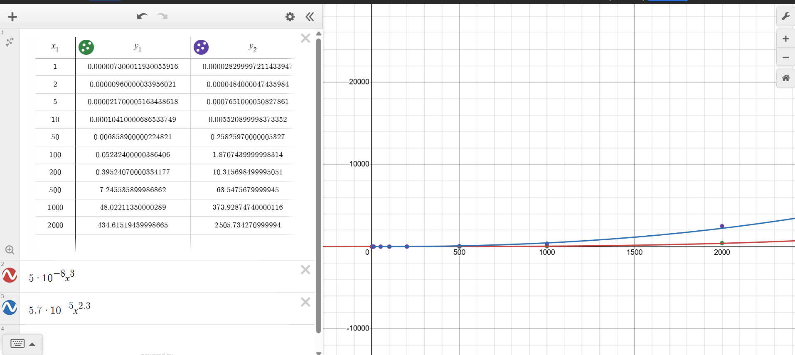
Data as a Graph:

Slide 16
What the Data Shows:
At low input sizes the difference between standard and strassen is negligible at best.
However, as n grows, strassen seems to become more ineffective.
This is due to the overhead and recursive nature of Strassen.
Because of this, Strassen doesn’t become practical to implement till you reach extremely high values of n.
However, we are unable to get our program to reach these input sizes due to hardware limitations.

Slide 17
Final Thoughts
Things we could have done differently:
Include more matrix multiplication algorithms
Find a way to visualize the algorithm
Problems we faced:
Hardware limitations
Finding times to meet and work on the project
Things that went well:
Creating the code for the algorithms
Collecting and interpreting the data gathered

Slide 18
Sources
Matrix Multiplication Gif - https://www.learnpdc.org/PDCBeginners/5-applications/matrix-multiply.html
Graph - https://www.desmos.com/calculator
Pie Chart - https://www.meta-chart.com
Neural Network image - https://www.jeremyjordan.me/intro-to-neural-networks/
Abe Lincoln image - https://www.researchgate.net/figure/mage-of-Abraham-Lincoln-as-a-matrix-of-pixel-values_fig1_330902210

Slide 19
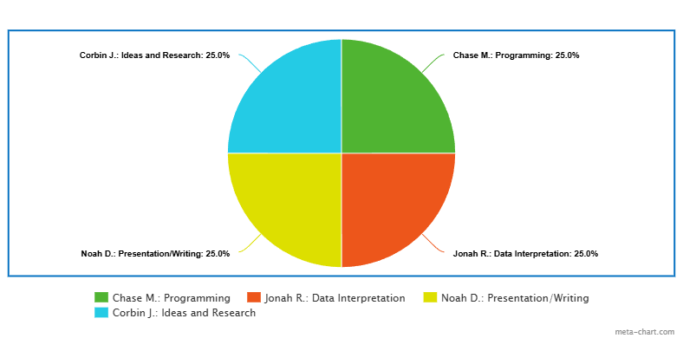
Who did what

